Slide 1


SMART Garden Automated Indoor Gardening System
Group 34
Ryan Hassan [CPE]
Kevin Lorch [CPE]
Lauren Melancon [EE]
Jonathan Wallhauser [CPE]
Notes:
Hello Everyone, This is group 34 presenting our project – the SMART Garden, an Indoor automated gardening system. Our Group members are:

Slide 2

Introduction
The SMART GARDEN is an automated indoor gardening system which provides accurate sustainment of a variety of plants with help of a dynamic database.
Notes:
So, what exactly is the SMART Garden? Simply put, the SMART Garden is our rendition of an automated indoor gardening system. The SMART Garden provides care and helps stimulate growth of a variety of different plants which are chosen from the SMART Gardens dynamic plant library.

Slide 3

Motivation
Inflation on the Rise
In 2022, inflation was up 6.5%. This add onto the previous 7.1% the year before.
Supply Chain Struggles
According to Morning Consult's latest U.S. Supply Chains & Inflation report, over half (51%) of consumers surveyed in March 2022 reported experiencing product shortages of specific types of groceries and food, up from 43% in September 2021.
Maximized Usability for the Everyday Person
With the popular of plant ownership and gardening on the rise, the engineers were motivated to provide a way for the everyday end user to maximize their positive results with an easy to use SMART Garden system.
Notes:
Where did the motivation come from?
Our Motivation was driven by three main points.
The FIRST being INFLATION. Did you know that in 2022 alone, inflation was up over 6%? This adds to the 2021 total of over 77 percent the year before.
The second main point of motivation behind the smart garden is the everyday supply chain struggles the United states faces to-date. According to a study from the Morning consults supply chain report -- over half of constumers in the market have reported experiencing some type of shortage in the grocery store. Whether that be eggs, milk, or their favorite veggie, the consumer is having a harder time than ever finding the goods they want.
The final main point of motivation is simple. Maximizing access to the everyday consumer. Plant ownership and hobbyist gardening is on the rise. This invigorated us to provide a reliable and fun way to keep plants in the everyday household without the downfalls of garden owenership

Slide 4

Objectives and Goals
Create a Dynamic Automated Garden system
Automate house plant care
Create a webapp that displays areas of interest
Maintain system and plant integrity through end of life
Scalable system that can range from 1 to many SMART Garden systems and maintain overall goals
Notes:
The SMART Garden objective and Goals:
First, we have the main objective of creating an Automated, dynamic gardening system
Secondly, the SMART Garden will automate house plant care
The SMART Garden will include a web application that displays areas of interest and stat lines for the end-user
Next, our SMART Garden is set to maintain and help provide growth to the plant in the housing through the end of its life.
AND Finally, the SMART Garden will be a scalable system. Meaning, there can be a single unit or many units and they will still all provide and maintain the rest of the roles and objectives put in place.

Slide 5
Advanced & Stretch Goals
Develop
Create a mobile app to enhance usability on multiple fronts
Optimize
Include a solar array for natural power and recharge of the lithium-ion battery
Maximize
Maximize efficiency with on-board plant selection options without the webapp support
Waterproof
Seal and waterproof the entire electronic system
Notes:
Now for our stretch an Advaanced goals
First off – we would like to include a mobile application to enhance the overall usability of the SMART GARDEN
Another advanced goal is putting a solar array in place for a natural and reliable source of power for our lithium-ion batteries
The next stretch goal in the ability to maximize efficiency with on bopard plants controls and selections without needing to rely on the web or mobile app
And our last advanced goal is in weather sealing our SMART Garden. Waterproofing the system would increase overall resilliance

Slide 6
SMART Garden Requirements and Specifications
Requirement | Specification
Battery Operated | 1200 mAh 2 9 Volt battery configuration
Portable Design | Length – 18 in. Width – 10 in. Height – 7 in.
Dual Pump | <70 L/Hr pump rate
Wireless Communication to Webapp | WiFi Connectivity
Weather Sealed | IPX4 or better
Battery | Rechargeable Lithium-Ion
Easy to Relocate | Less than 10 pounds

Slide 7
Project Approach
R&D
Research and Order Required Components
Design
Design PCB
Develop
Develop Hardware Prototype
Develop
Develop Software Prototype
Polish
Polish Design
Fabricate
Fabricate Final Product
Notes:
So, here we have structured a general outline for our plan of aattack throughout this process.
First was the Research and Design phase of the project
Following that we implemented aand dsigned our PCB
Then we began to develop a hardware prototype
Next was our software prototype
From this points we plan to polish the design of the SMART Garden and then of course fabricate and push the final product

Slide 8
Project Constraints
Cost of building the SMART Garden must fall within the project budget.
Water based project requires thoughtful layout of electrical components.
Project must meet all standard engineering ethics.
SMART Garden must have internet connectivity.
Size of the housing must be taken into consideration

Slide 9
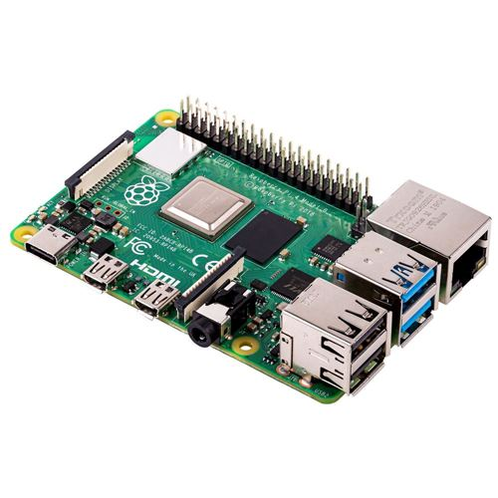
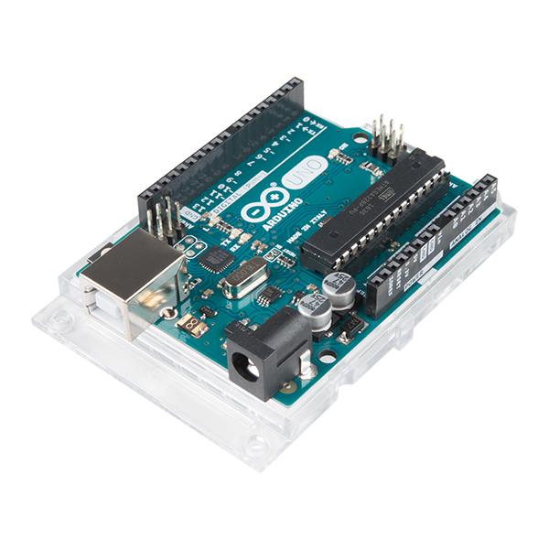

Micro-Controller Comparison and Selection
Arduino Uno
Raspberry Pi

Slide 10
Arduino Uno
Microcontroller Development board
16MHz processor
No ports, but achievable though shield use

Slide 11
Raspberry Pi
Single board computer
1.5GHz processor
Multiple ports

Slide 12
The Arduino Uno was selected

Slide 13
Lauren's Section

Slide 14

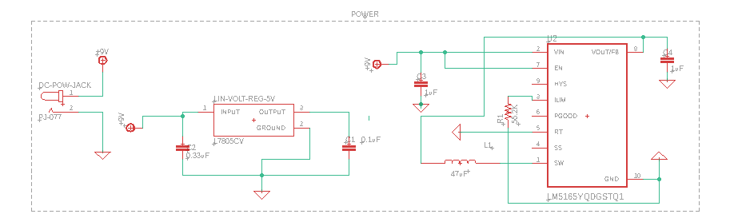
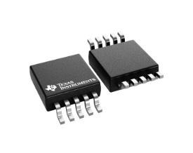
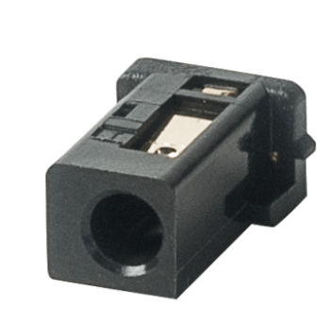
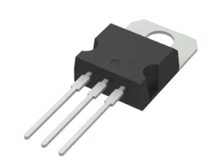
Power Schematic
2 x 9V Lithium-Ion Battery
Connected via DC power jack to PCB and directly to Arduino Uno
LM7805 Voltage Regulator
Step down 9V supply voltage to 5V
Capacitor values chosen via information provided on datasheet
Output Current: 1.5A
LM5165 Buck Converter
Step down 9V supply voltage to 3.3V
Resistor, capacitor, and inductor values chosen via information provided on datasheet
Output Current: 150mA
Notes:
My name is Lauren and I'll be going over some of our systems components and our overall schematic and PCB design
To start off with, we will be reviewing the power supply schematic for our SMART Garden.
The first thing we will be discussing is our rechargeable battery. Prior to finalization of all components, our initial design choice was to use 1 x 9V Lithium-Ion battery to run the entirety of our system. After further research on the current capacity of the 9V battery purchased, we realized that while the 9V would be able to power our system, the battery was more than likely going to drain very quickly if we wanted to pull data from our sensors on a relatively consistent basis.
In reaching this conclusion, we decided to opt for 2 x 9V batteries, one to power our microcontroller, and a second to power the remainder of our PCB. The third possible option, which is still being discussed, is to use a battery pack with 6 x AA batteries, in place of each singular 9V battery to increase to over all current capacity of our supply voltage and consequently increase the longevity of our systems battery life.
Next we'll discuss the voltage regulator and buck converter. For our project we are using multiple sensors and components that require a voltage of 5V or 3.3V. Due to the capped output current on the 3.3V and 5V power line pre-installed in the Arduino Uno, we decided to implement the 7805 voltage regulator and the LM5165 Buck Converter as shown in the schematic on screen. Together these two devices will be connected directly to our 9V supply voltage and will be powering all PCB board components with the exception of the Arduino Uno Microcontroller
Why the LM7805?
Why a Buck Converter instead of another Voltage Reg?
Why not power everything using the 5V and 3.3V pin on the Arduino?
Why use 2 9V batteries instead of one – talk about possible change to 6 x AA for the purposes of extending the battery life (drain slower due to higher current capacity)

Slide 15
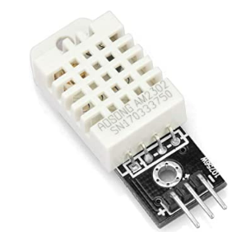
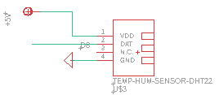
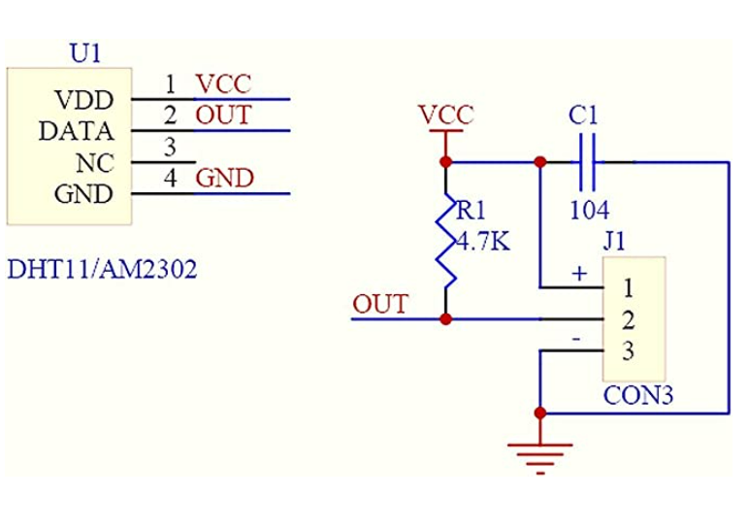
Temperature and Humidity Sensor
DHT22 Temperature and Humidity Sensor
Sampling period: 2 sec
Transmission distance: <= 100m
Operating Voltage: 5V
Operating Current: ~1 - 1.5mA
Stand-by Current: 40-50uA
Notes:
The first of three different types of sensors that we will be using in our project is the DHT22 temperature and humidity sensor. This sensor can measure temperature from -40°C to 80°C and humidity from 0% to 100% with an accuracy of ±0.1°C and ±0.1% humidity and has a transmission distance of up to 100m.
The other main option we discussed was the DHT11. We chose the DHT22 variation over the DHT11 sensor, because despite its slightly higher price and slower sampling time, it offers better resolution and a wider temperature and humidity range than the DHT11.
In addition, the DHT22 sensor was chosen due to its built in breakout board. This breakout board contains the required pull-up resistor and capacitor depicted in the schematic located at the bottom of the screen. The addition of this breakout board helps to reduce unnecessary complexity in our PCB board design.
No external pullup resistor needed – integrated into breakout board – capacitor used for wave filtering
The DHT22 sensor has a better resolution and a wider temperature and humidity measurement range (more expensive than DHT11 and longer sampling time 2 sec vs 1 sec)
Speak on what sensor does and how it works
Speak on placement in final design / range of device / power connection
Possibly talk about DHT11 alternative and why that was not chosen
Single Bus Bidirectional
4 pin sequence number
Temperature range from –40 – 80degrees celcuis
Humidity range from 0-100%

Slide 16
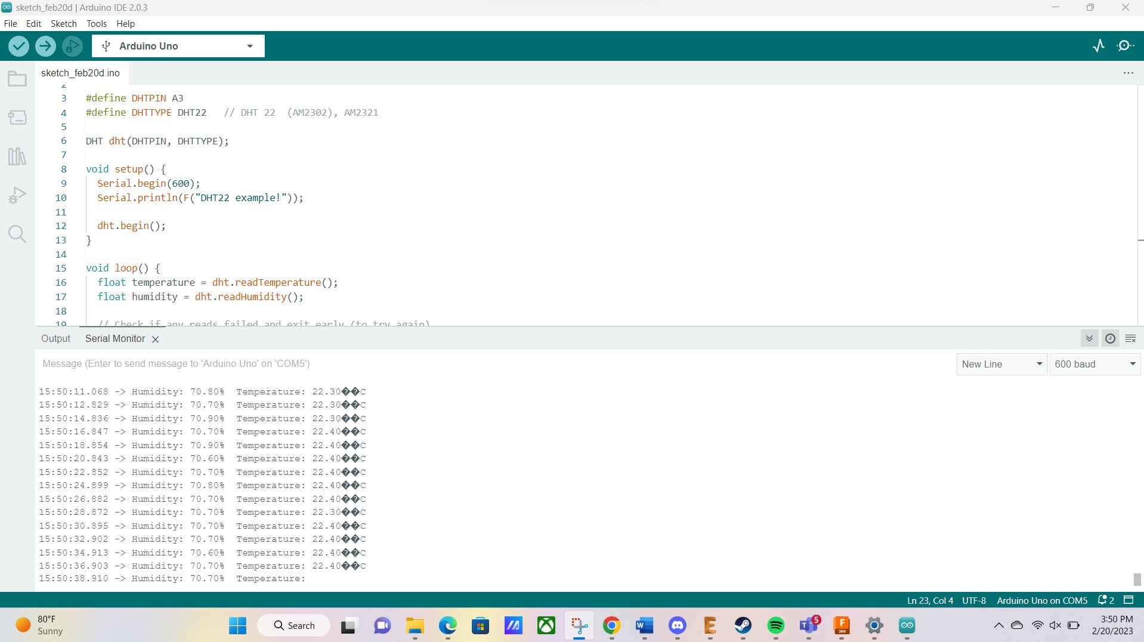
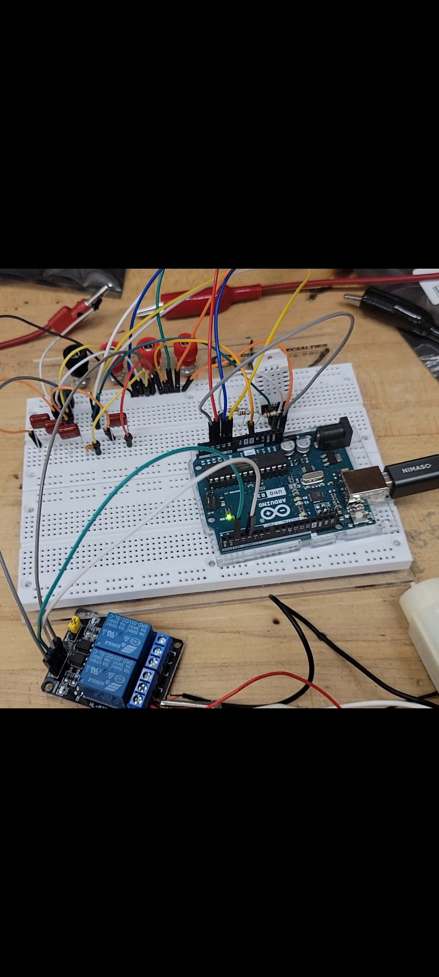
Temperature and Humidity Sensor
Notes:
This is a small insight into our initial hardware testing for our temperature and humidity sensor. Depicted on the right is the output received via our test code which was run using the Arduino IDE software. Slight changes to test code need to be made to get rid of symbols in the output, but overall the reading was successful and outputted correct temperature
Initial Temp Humidity sensor test
Speak on output – Slight changes to test code need to be made for the output but overall reading was successful and outputted correct temperature
(Possibly going to change C to F)

Slide 17
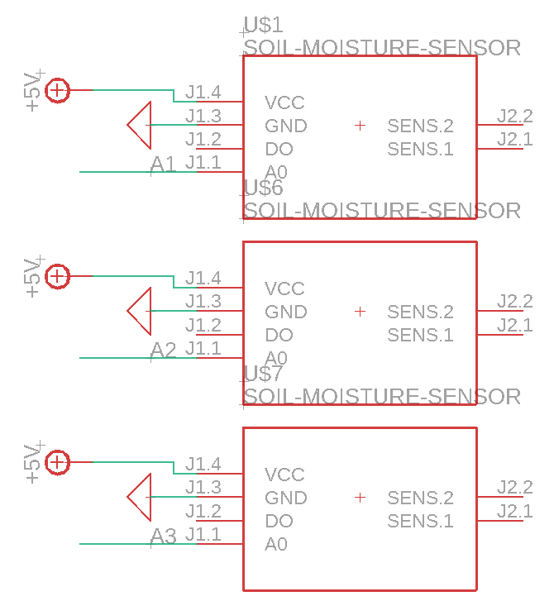
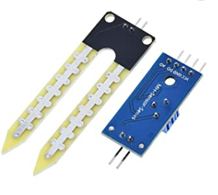
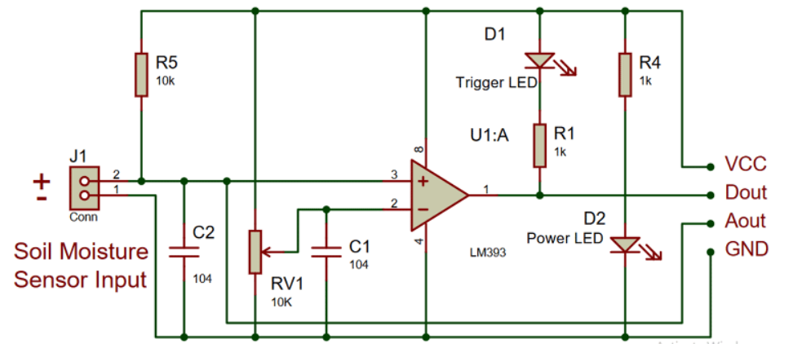
Soil Moisture Sensor
LM393 Soil Moisture Sensor
Adjustable Sensitivity
Module Dual Output
Operating Voltage: 5V
Operating current: <20mA
Notes:
The second sensor that we will be using in our SMART Garden is the Soil Moisture Sensor.
This sensor consists of a small module containing the LM393 High Precision Comparator and a built-in potentiometer
Included is also a probe which is made of two exposed conductive plates that act as a variable resistor. The resistance of this probe is inversely proportional to the soil moisture of the device. Therefore the more water in the soil, the better the conductivity, and the lower the resistance. Following the same logic, the less the water there is in the soil, the worse the conductivity, and the higher the resistance.
We plan on using three soil moisture sensors in our project. Due to the fact we are growing herbs, two probes will be placed at the surface level of our garden to accurately gauge water content surrounding the herbs shallow root systems. The third probe will be placed in the bottom third of the main soil compartment, as a means to regulate and check for irrigation issues.
Speak on physical placement of probes in final design / what sensor does and how it works / why this was chosen over more efficient sensor / Connections to power supply
Module Dual output
Adjustable sensitivity
3.3-5V operating range

Slide 18
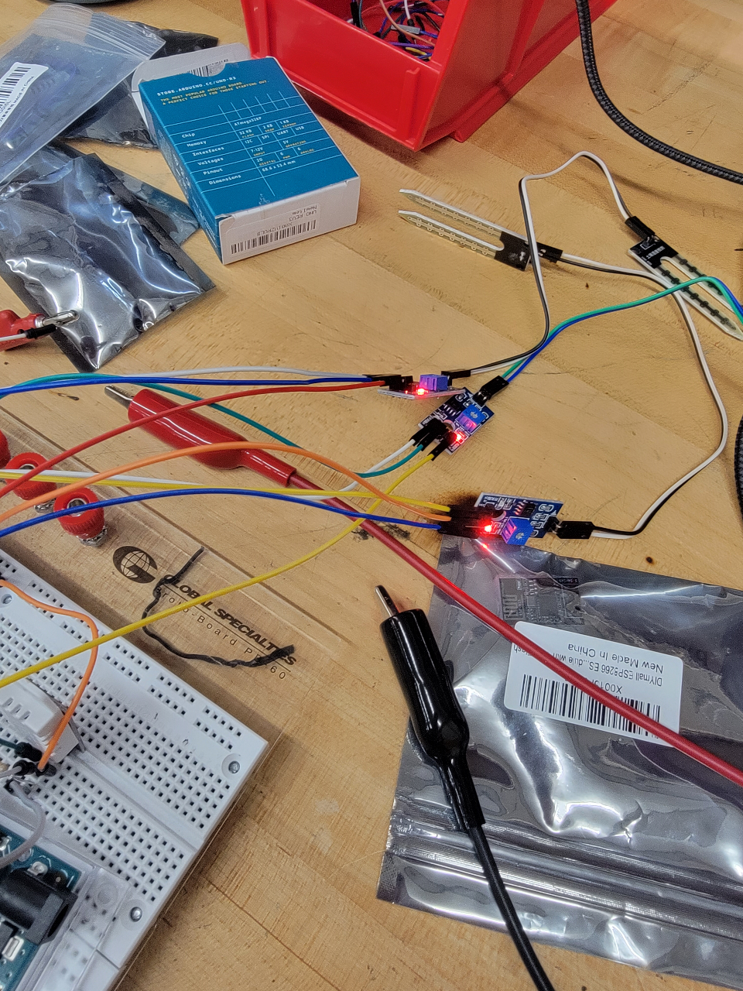
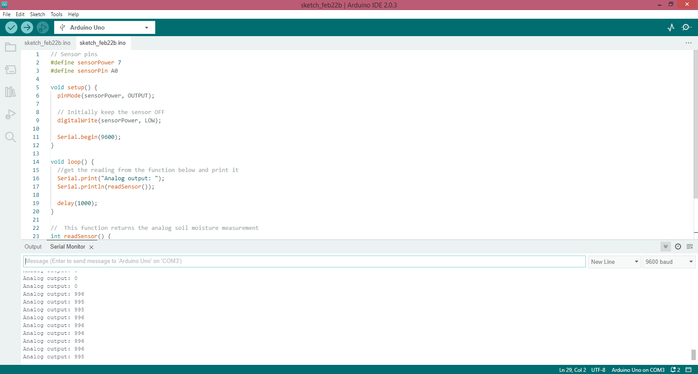
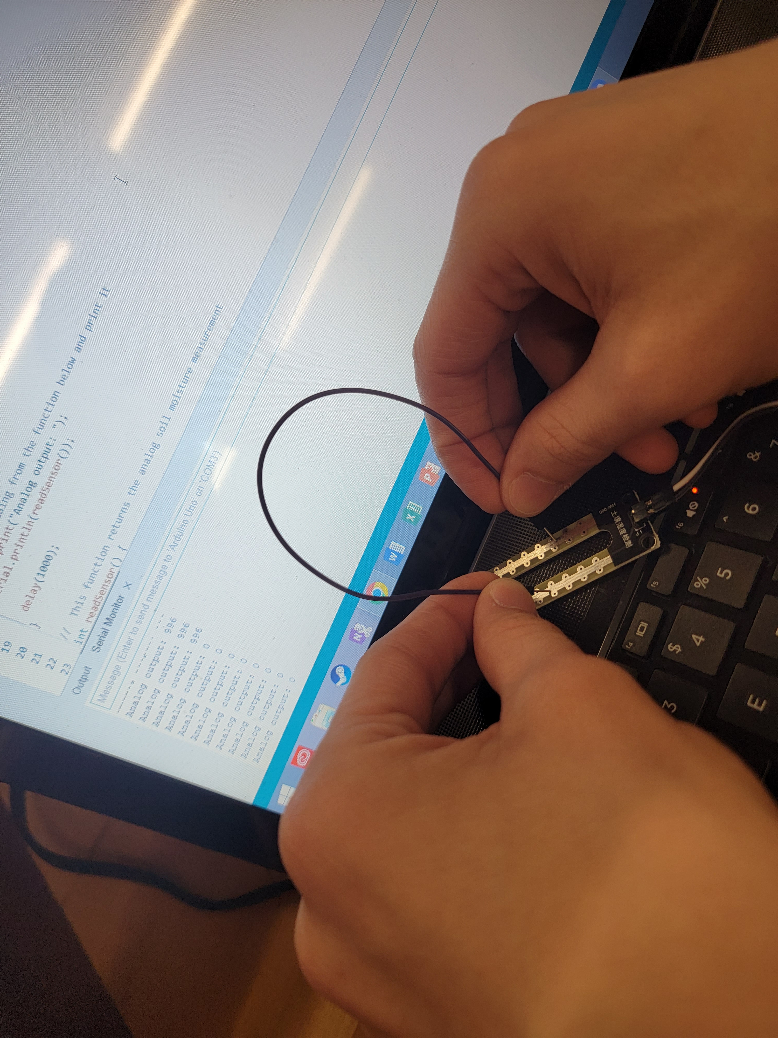
Soil Moisture Sensor
Notes:
Here we have our initial test for our soil moisture sensor. In our tests, and in final application, we will be using the Analog pin on the soil moisture sensor to help prevent corrosion of the device and to provide our user with a more accurate reading. The test reading shown, was successful, the module outputted a value in the upper threshold of the sensors range when there was high resistance, or dry conditions, and outputted an 0 when the sensor was shorted, simulating low resistance, or extremely wet conditions

Slide 19
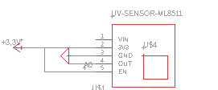
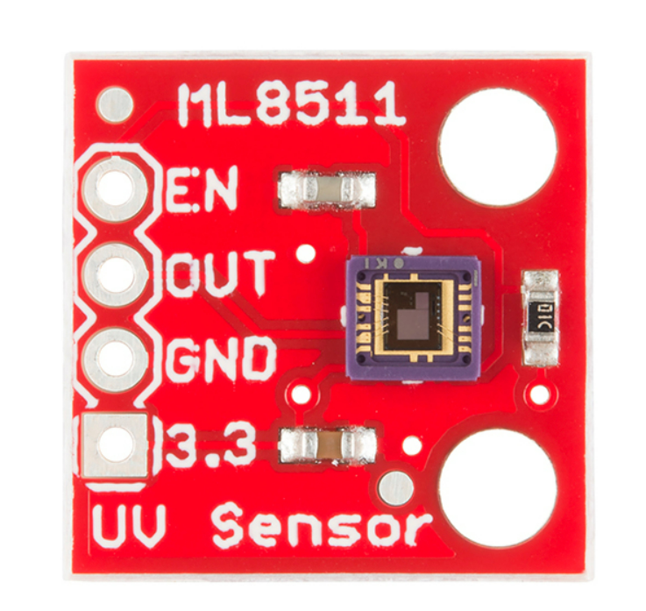
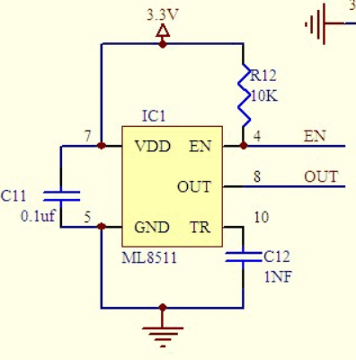

UV Sensor
ML8511 UV Sensor
Operating Voltage: 3.3V
Operating Current (Active): 300uA
Supply Current (Stand-by): 0.1 uA
Notes:
The last of the three sensors we will be utilizing in our project is the ML8511 UV sensor. .
The ML8511 has a Photodiode which detects light in the 280-390nm wavelength. And that range falls within part of the UVB (burning rays) spectrum and most of the UVA (tanning rays) spectrum. In addition to that it has internal Embedded operational amplifier that converts photocurrent to voltage output depending on the UV light intensity. The ML8511 sensor has a low current draw, an operating voltage of 3.3V, and is easy to interface with the Arduino Uno microcontroller. We are waiting on this part to arrive so no testing has been done yet
The purpose of this sensor is to
UV light has many benefits to plant growth. It has been shown to improve the plant’s dry weight, growth potential, and size, increase the rate of photosynthesis AND In some cases, it has been shown to even improve the smell and taste of plants.
Speak on what UV Sensor does and how it works / purpose for component within design/ power connection / don’t read off current draw but state in is low

Slide 20
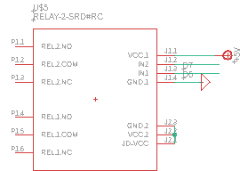

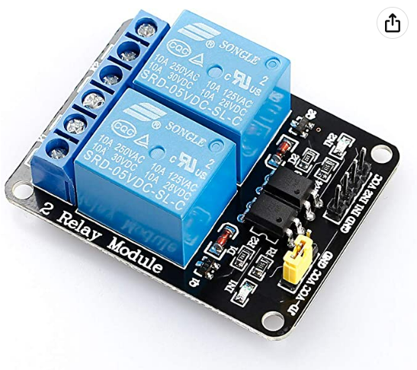
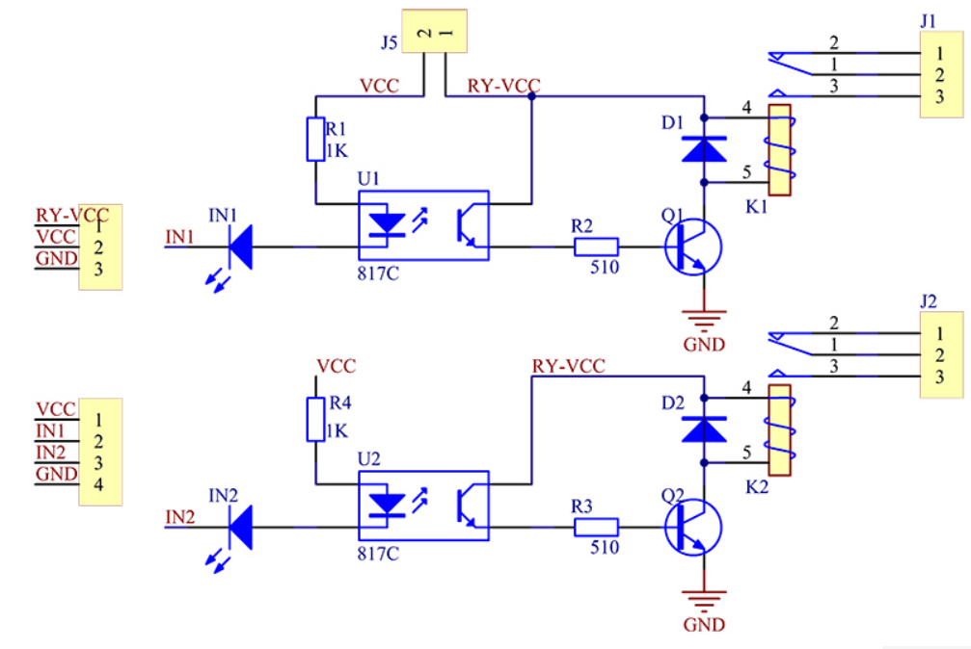
2-Channel Relay
Sunfounder 2-Channel Relay
Operating Voltage: 5V
Trigger Current: 20mA
Relay Coil Current: 70mA per channel
Load Current: 10A max
Response speed: 10ms
Notes:
Our Project requires the use of 2 small 5V water pumps that need to be activated on command in order to achieve the desired automated watering system our project promises. In order to activate these pumps we decided on using the Sunfounder 5V 2-Channel Relay.
This relay has a driver current of about 20mA and draw apporximately 140mA when both relays are acivated. It also comes with built-in octo-couplers on the logic inputs. These octo-couplers offer complete electrical isolation between the logic control input and the relay power and act as an extra layer of protection in the event of a major failure on the relay’s AC load. In addition, another thing that made this relay desirable, is the built in flyback diodes.
These flyback diodes, which are connected in parallel with the relay coils, serve to safely shut down current after the relay coil has been
de-energized. We have tested the relay multiple times, both on its own, and with the water pumps connected and there have been no issues so far
Speak on Octo-coupler and flyback diode (Reason for choice of component) / power connections/ water pumps being used / Why

Slide 21
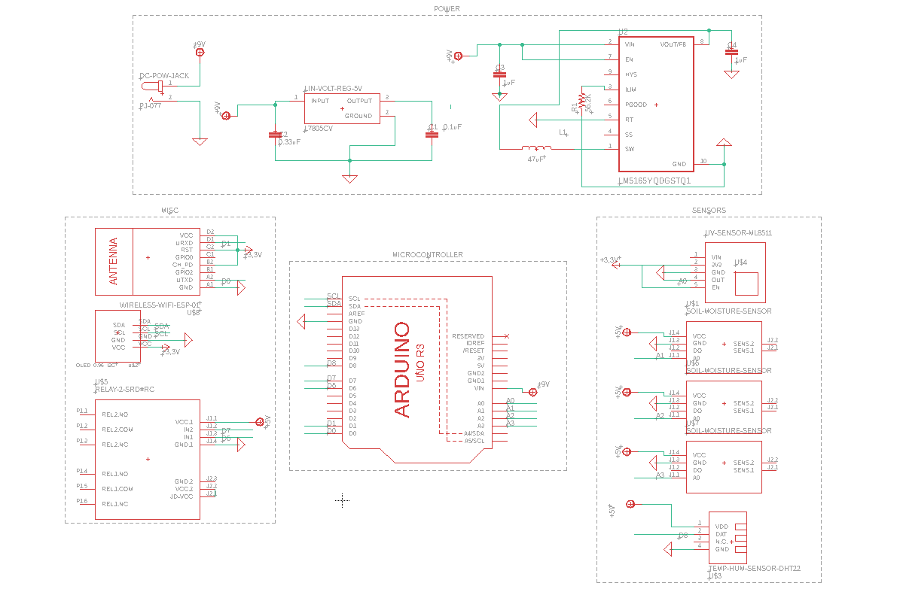
Complete Schematic
Notes:
Here we have our complete schematic. Located on the top of the screen is the power supply circuit previously discussed. In the center is our Arduino Uno microcontroller connected to a 9V input. On the right side of the screen we have all 5 sensors, with the soil moisture sensors and temp/humidity sensor connected to the 7805 voltage regulator, and the ML8511 UV sensor connected to the output of the buck converter. Lastly on the left side of our screen we have our relay module, OLED display, and Wi-Fi module which will be discussed in more detail soon. Both the OLED display and the Wi-Fi module will be power via the Buck Converter, and the Relay will be powered via the 7805 Regulator

Slide 22
Known limitations/current problems?

Slide 23
Kevin’s Section
I am assuming we can/will move these around to where they will fit better.

Slide 24
Kevin’s report topics for contribution ideas
Batteries. voltage, why use rechargeable. Lithium-Ion
Talk about why it’s the size it is. While designed with indoors in mind, outside could be viable?
Why use wif-fi over BT –better range, better power, better security, non-prohibitive data limits.
Standards used – Arduino IDE standards obviously required (e.g. digitalWrite( #, High/low/etc?)), Database Wi-Fi standards?
Software used list. Arduino IDE, LAMP stack(did someone else write about this?), Github

Slide 25

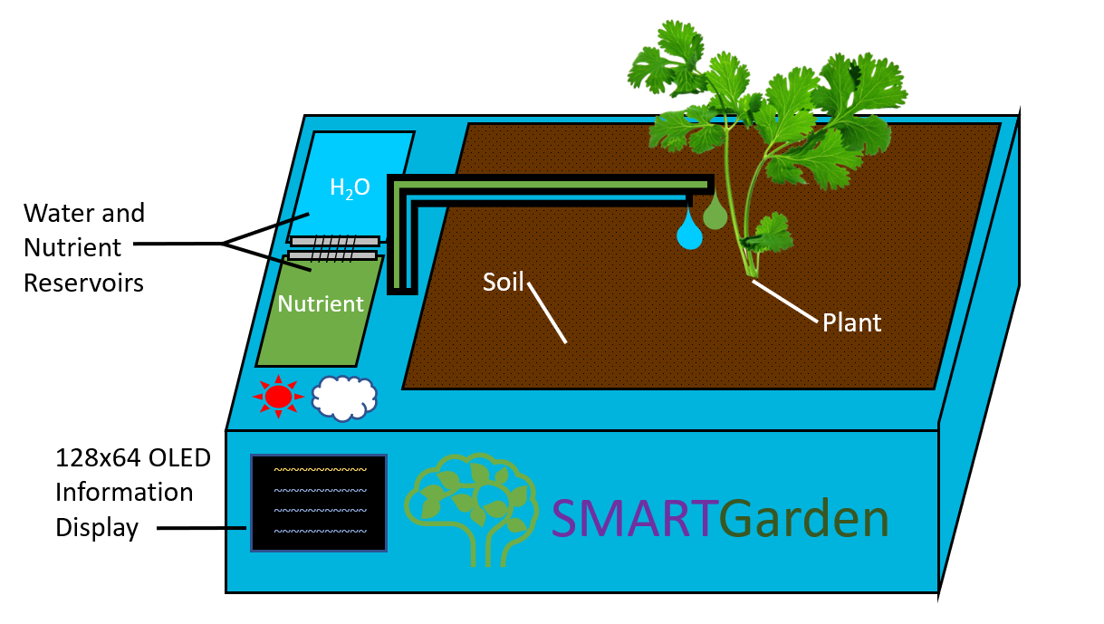
Design – Side View
Notes:
This is our initial rendition of what the SMART Garden would look like if designed as a product sold in stores, though we can’t guarantee ours will look quite like this.
This side view lets us see the informational display and the closed panels for the water reservoir and the nutrient reservoir, as well as what the garden will look like while it is in use.

Slide 26
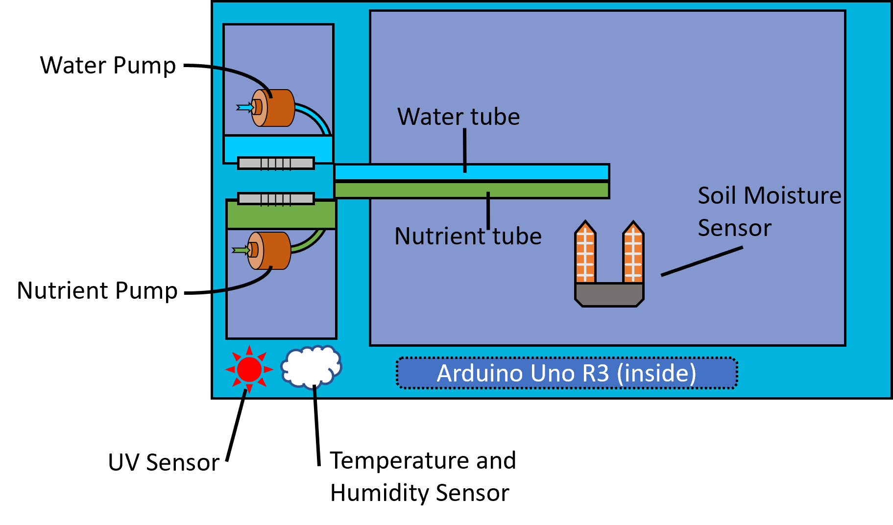
Design – Top View
Notes:
The top view diagram labels many of the smaller parts. You can see the individual pumps for the water and nutrient reservoirs as well as the tubes that will take each one to the plant itself.
Under where the soil was we can now see a model of the soil moisture sensor, though we plan to have multiple to get a more reliable reading.
Above where the display was, we can see the location of the UV sensor and the temperature and humidity sensor.
Behind the logo is where we plan to mount the Arduino Uno R3. This placement is so that it is relatively close to all of the other devices involved in the garden without messy and overlapping wires.

Slide 27
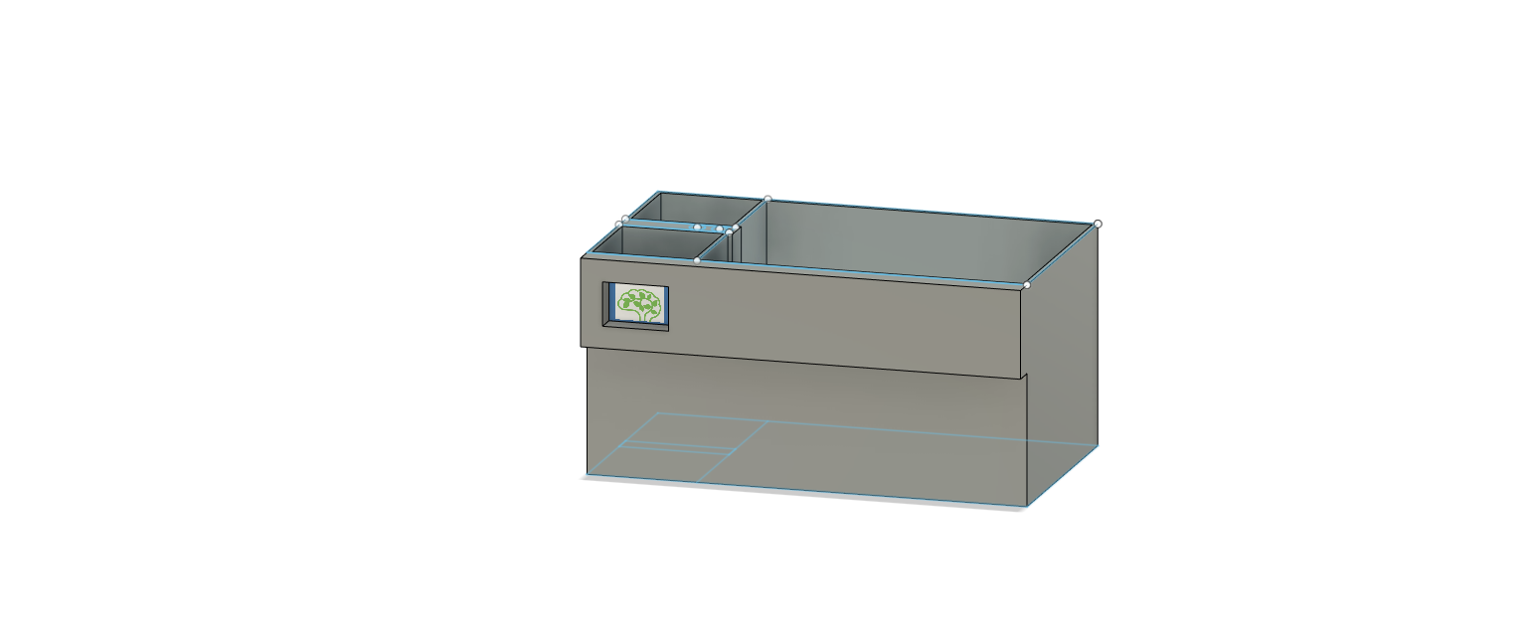
Design – Initial Mock up
Notes:
Model Made by Lauren
This is roughly what our prototype container for the garden looks like. This version is deeper to accommodate a larger supply of water and nutrients, as well as any plants with more restrictive requirements for growing space.

Slide 28

Design Justification
This initial design we made out of wood is about 12 inches wide and deep, and about 18 inches long.
This is large enough to accommodate a large variety of plant species without taking up an inconvenient amount of space in the home.
The depth of the container allows plenty of space for root growth.
The area allows for a few specimens to be grown at once, provided the rest of their needs can be met. Some types of plants need more space than others.
Notes:
Slide sequence-
Idealized design 1 and 2
Current mockup
This slide

Slide 29
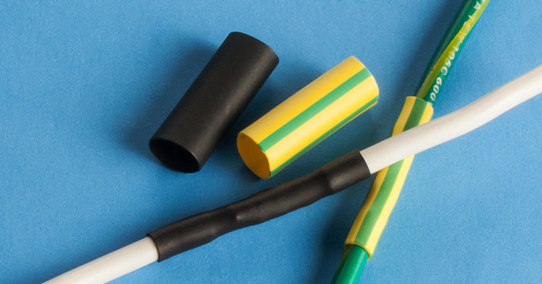
Waterproofing
The SMART Garden will need to be waterproof to both keep water in the soil and to protect the wiring between our components.
Basin – water-resistant paint will protect the wood we will use to construct our prototype’s frame.
Circuitry – we can use a few methods to protect our wiring and components, such as heat-shrink tubing or circuit board waterproofing spray.
Notes:
Basin: It is important that we use water-resistant paint so that it doesn’t degrade and get into the soil. If we get paint in the soil, we would be compromising the health of the plant, the user, or both.
Circuitry: Heat-shrink tubing shrinks when heated to form a tight seal around the wires wherever they may be vulnerable. Waterproofing spray is a coating over any component that protects the surface of the circuit board from getting accidentally short-circuited by the presence of moisture.

Slide 30
Batteries
9V batteries provide enough voltage to power the Arduino Uno, which has an operating range of 6-20 volts, with an optimal range of 7-12 volts.
We selected rechargeable lithium-ion batteries for our application. This reduces the amount of waste created by our garden and the cost to the user because they can recharge the batteries at home.
Our 9V Lithium-ion batteries have a capacity of about 600 mAh compared to 9V Alkaline or Nickel-Metal Hydride batteries, which have less than half this capacity.
Notes:
B2: Since the SMART Garden is geared toward being convenient and accessible, being able to recharge the batteries instead of using another set of disposable batteries means fewer trips to the store as well.
B3: Longer battery life means you can be gone for longer while being ensured that your garden will be taken care of.
B3 source: https://www.microbattery.com/blog/post/battery-bios:-everything-you-need-to-know-about-the-9v-battery/

Slide 31
Standards Used
We have done our best to design the PCB following as many standards as we can regarding components and layout.
Since we will be transmitting data via Wi-Fi, we will be following the IEEE 802.11 standards of Wi-Fi communication.
In programming in the Arduino IDE we will follow some standards for the hybrid C/C++ language used.
Notes:
Updated to not be extremely long:
B1: We have placed our components where they will be easily accessible and won’t be too crowded, and have included protections, such as flyback diodes, for sensitive components where necessary.
B2: this is a basic set of standards for wireless communication using Wi-Fi brand communication technology
B3: ,though these may overlap with some of the standards for programming other microcontrollers.
Additionally, we will have to follow any agreed-upon standards of variable-naming, such as using camelCase for all variables.
Old:
B1: We have placed our components where they will be easily accessible and won’t be too crowded. Though we are still finalizing the design,
we have thus far avoided any sharp corners on the copper layout, and have included protections for sensitive components where necessary such as flyback diodes.
B2: IEEE 802.11 provides a basic set of standards for wireless communication using Wi-Fi brand communication technology, [though there are other versions with additional suffixes like 802.11ac or 802.11be]
B3: The Arduino IDE has some unique functions separate from other microcontrollers, even if they sometimes have methods with similar effects. For example, pinMode(), and digitalWrite()
Additionally, we will have to follow any agreed-upon standards of variable-naming, such as using camelCase for all variables.

Slide 32
Software Used
The Arduino IDE was used to create the programs (known as ‘sketches’) for the actual function of the garden.
Our main method of discussing tasks and scheduling meetings was to use a Discord server.
Github will be used to allow the entire group to collaborate on code for the Arduino and the web component.
We are going to implement a LAMP stack onto a web-based database that the garden will retrieve data from and send sensor readings to.
Notes:
Intro: Many different programs and software are used in this project
B1: It was also used to download relevant libraries, compile the sketch and upload it onto the Arduino Uno.
B2: In addition to basic communication, we can also keep track of helpful resources and data.
B3: {}
B4: We will be storing the data about each plant type on the web database rather than within the Arduino’s code, since the Wi-Fi module is our only method of communicating with the Arduino once it is ‘active’.

Slide 33
User interface
The user will select the needs of their plant by connecting to the garden via Wi-Fi and using our website.
Select by plant name from a list or input custom data.
The website will provide the data from the sensors on the project so that the user can see how the SMART Garden is caring for the plant.
Mobile app (stretch goal mention?) will provide push notifications if the conditions become inhospitable.
Notes:
Inhospitable = too little/much UV exposure or too low/high humidity. Every plant is different, so these conditions can vary.

Slide 34

Wireless Communication Method
Method | Data Rate | Range | Power Consumption | Security
Wi-Fi | ~23-190 Mb/s (8Mb/s Arduino Uno) | 20 m | 0.01 - 100 mW | Key-matching
Bluetooth | ~24 Mb/s (8Mb/s Arduino Uno) | 10 m | 40 – 100 mW | WPA3 / WEP
The data transfer rate is not an obstacle since our project doesn’t require transferring large files or a huge quantity of data.
Wi-Fi’s higher range means fewer limitations on where the garden can be placed.
Lower possible power consumption means the battery can last longer than if Bluetooth were used.
Wi-Fi is more secure than Bluetooth and products must be officially certified to be allowed to claim they are “Wi-Fi CERTIFIED”
Our final choice was to use Wi-Fi.
Notes:
Feasible data rate is based on Arduino Uno clock speed, so this is the maximum theoretical data rate we can get in or out.
We prioritized battery duration, range, and security so that we can reduce the amount of stress and limitations on the user.

Slide 35
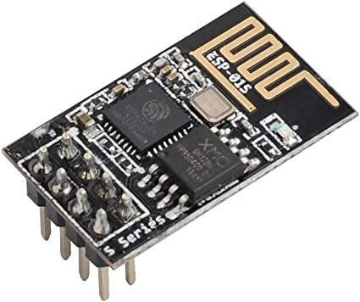
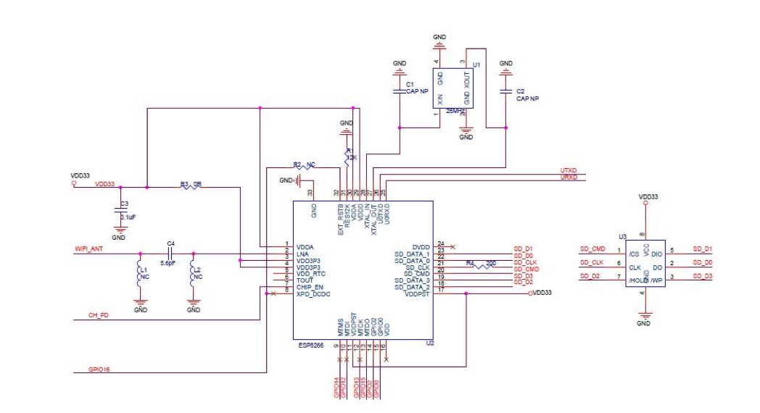
WiFi Serial Transceiver
ESP8266 ESP-01S WiFi Serial Transceiver Module
Built-in TCP/IP
4MB of Flash Memory
3.3V operating voltage
Standby power consumption < 1mW

Slide 36
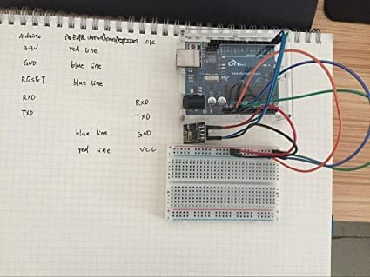
WiFi Serial Transceiver

Slide 37
GANTT SLIDE HERE
optional

Slide 38
Budget

Slide 39
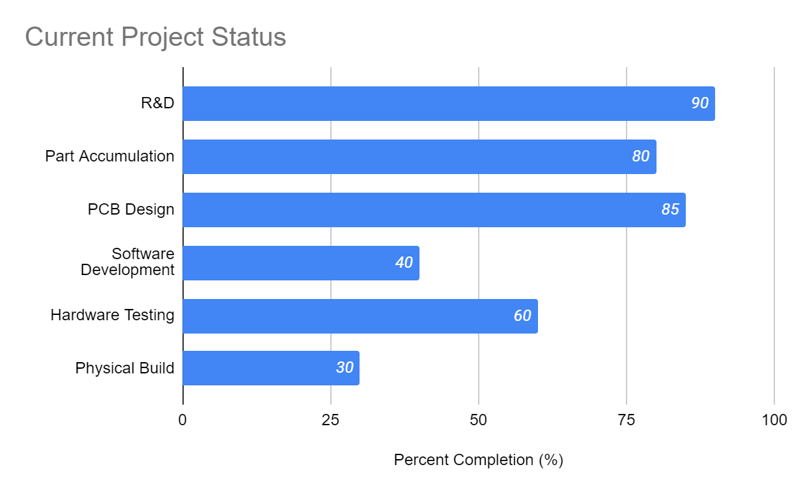
Project Status
Jonathan: Physical Build/Software Testing
Kevin: Database/Software Development
Ryan: Mobile App Development/Wireless Communication
Lauren: PCB/Hardware Testing
Notes:
And to wrap things up, here is our current project status. Noticer that Research and development is nearly complete, we are just allowing some leeway for improvements in the design
We have accumulated almost all parts as well, simply deciding on some small components like the UV sensor
PCB design is nearly completed with its order on the way
The physical build and software development is where the remainder of effort will go from this point
\
I am in charge of the physical construction of the housing as well as testing the software
Kevins main role is the lead of software development and database structure.
Ryan will help with mobile and software development while also making sure our wireless communication is in place
And lauren is taking lead on the PCB and hardware testing side of things
Thank you all for sitting through our critical design review and have a great day!

Slide 40
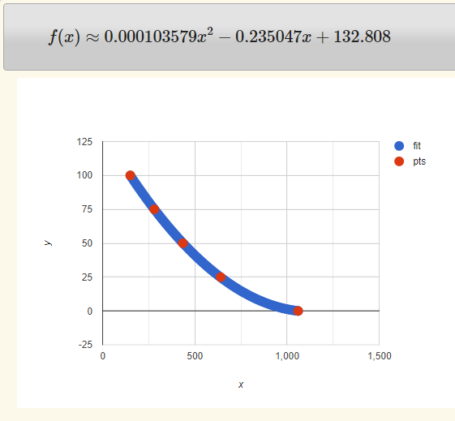
Soil Moisture Level Equation

